Slide 1

COLLISION OF ROBOTIC BEES
Camila Barona cabrera
Mariana Gómez Piedrahita
Imagen tomada de: https://es.kisspng.com/kisspng-ho3fkn/

Slide 2
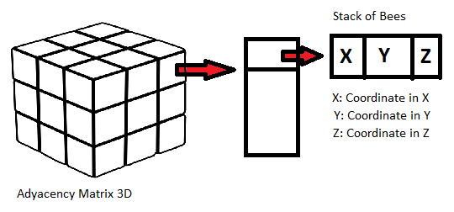
DATA STRUCTURE
Matrix 3D
Stack
Matrix 3D
Imagen cubo tomada de: https://blogs.20minutos.es/mati-una-profesora-muy-particular/tag/cubo/

Slide 3
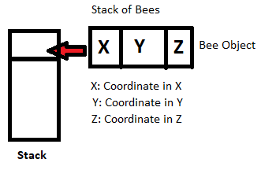
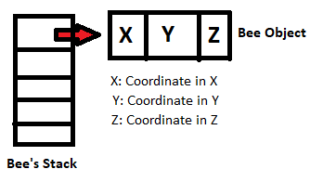
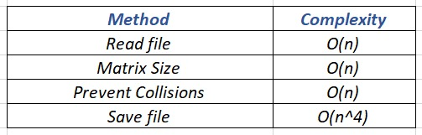
OPERATIONS AND COMPLEXITY
Insert
Remove

Slide 4
GOOD DATA STRUCTURE
As the main objective is to minimize the complexity of the main method, resorting to the use of adjacency matrices is one of the best options, since insert and read is O (1), counting them as the basic operations; likewise with the lists its complexity is very little O(1), ideal to maintain the low complexity that is needed. In addition, using matrices and lists is very familiar.
Less memory storage
Better execution time

Slide 6


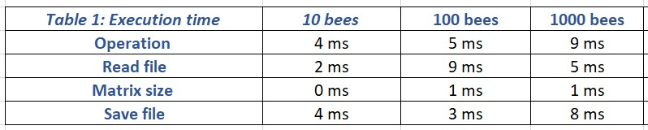
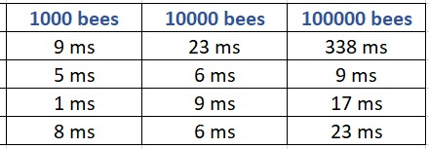
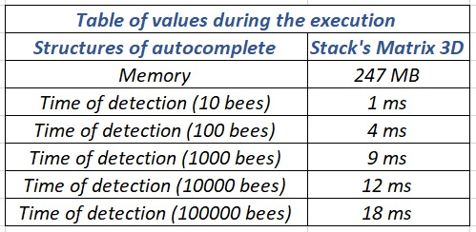
EXECUTION TIME MEMORY CONSUMPTION

Slide 7
Muchas Gracias por su Atención.

